Slide 1
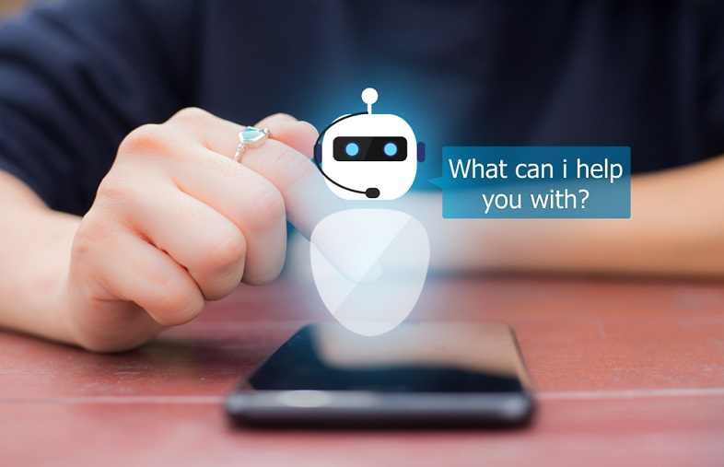
Taxi Chatbot
Taxi
Chatbot
Team Number : 01
Team Member : Ruturj Solanki
Dhruv Raval
Chris Chhotai
Pratinav Jinwal
Prem Patel
Team Number : 01
Team Member : Ruturj Solanki
Dhruv Raval
Chris Chhotai
Pratinav Jinwal
Prem Patel

Slide 2
What problem are you trying to solve?
Problems we are Trying to Solve:
This project aims to develop a Taxi bot utilizing Microsoft Azure, to automate booking a taxi .
Providing a smooth and speedy pickup experience is important which is generally not seen when you book the taxi through an app. It also provides 24*7 service without any human involvement.
It will also use Azure Cognitive Services to provide personalized, intelligent responses to users.

Slide 3
Why is this problem important and a good candidate for an AI solution?
Customers may access taxi services quickly and easily with the help of an AI-powered chatbot, skipping the hold time and difficult phone menus. Through a chat interface, customers can easily ask inquiries or specify their needs, and the chatbot may react promptly and precisely.
In order to give clients a more individualized experience, an AI-powered chatbot can be trained to comprehend specific customer demands and preferences. Customers may be more satisfied and loyal as a result of this.
Overall, an AI-powered chatbot for taxi services can improve client experiences, boost operational effectiveness, and cut costs, making it an excellent candidate for an AI solution.

Slide 4
What task will you perform?
Taxi booking: By requesting the customer's location, destination, date, and time, the chatbot may offer them options for available cabs.
Estimating the cost of a taxi ride: Based on the distance between the pickup and destination points, the chatbot may provide consumers an estimate of the cost of their taxi travel.
Answering frequently asked questions: The chatbot may respond to queries about the taxi service that are asked frequently, such as the service hours, accepted payment options, and cancellation policy.
Supporting clients: The chatbot can assist customers who have questions or difficulties related to their taxi ride, such as complaints or lost things.

Slide 5
How do you expect the solution will turn out?
Improved customer experience: The chatbot can increase customer happiness and loyalty by giving clients a quick and easy way to access taxi services.
Efficiency gain: The chatbot can handle numerous enquiries and requests at once, which lessens the workload of customer support agents and improves the taxi service's operating efficiency.
Personalization: The chatbot can be taught to recognize unique customer requirements and preferences, resulting in a more tailored customer experience and raising customer loyalty to the business.

Slide 6
What were the failures or challenges in completing the project?
Poor user adoption: The chatbot can be viewed as a failure if customers are not using it. This might occur if the chatbot is challenging to operate, doesn't offer helpful information, or falls short of client expectations.
Technical difficulties: Technical difficulties, such as server outages or network issues, might affect the chatbot's availability and dependability, which can negatively affect the user experience.

Slide 7
What changes did you make to resolve the issues or improve performance and what did you learn?
Analyze and troubleshoot: Specify the problems and gauge the success of the project. To find patterns, trends, and anomalies, assemble data and thoroughly analyze the system's behavior. Investigate the trouble spots and gauge the effect of suggested fixes.
Boost the resources and infrastructure: To increase the system's performance and scalability, upgrade the resources and infrastructure. This could entail improving cloud-based resources, network connectivity, or hardware.

Slide 8
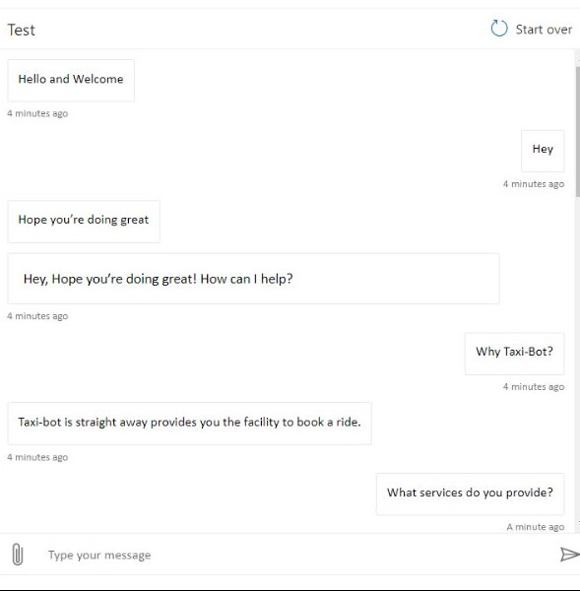
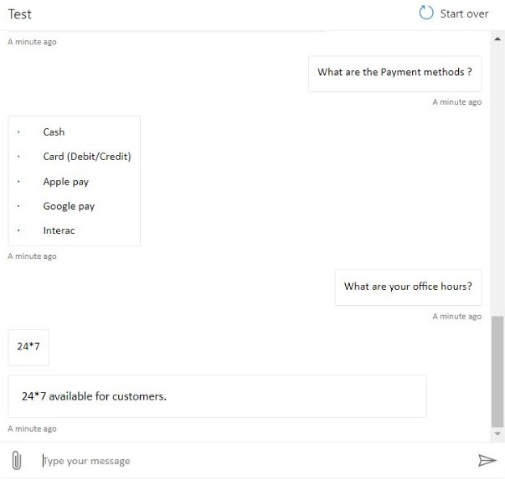
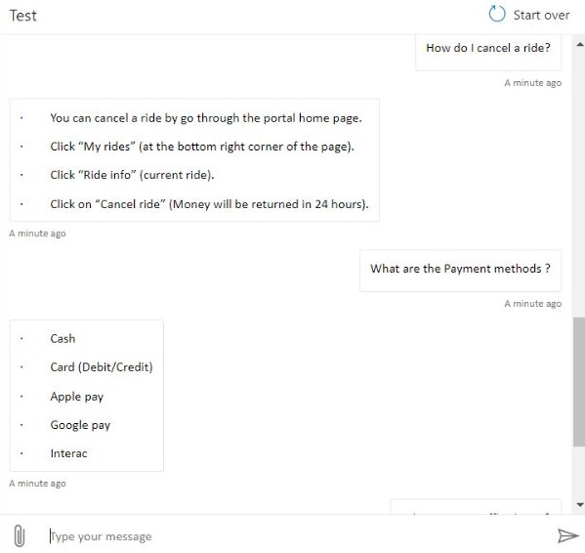
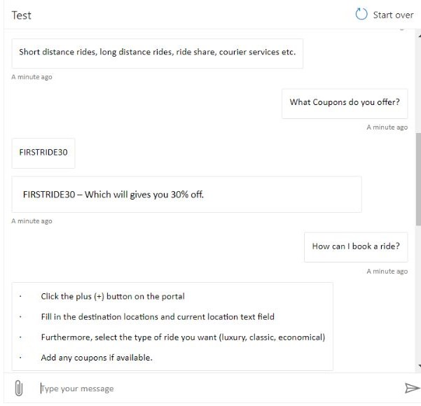
What do the final results look like?
The Final result of our project looks likes :

Slide 9
Did you solve the problem that you set out to solve? What are some final recommendations or thoughts about the project?
The needs of the user should come first when developing an AI chatbot. Users' needs should be taken into consideration when developing the system. Knowing consumer preferences and pain points may help create a chatbot that provides a customized and helpful experience, boosting customer satisfaction and loyalty.
Put security and data privacy first: As with any AI system that collects and analyses user data, it's crucial to ensure sure the chatbot is developed with security and data privacy in mind. Using the right security measures can help protect client information and maintain customer confidence.

Slide 10
For example, are there any opportunities for further improvement?
Integration with other platforms: The chatbot can be integrated with other platforms like social media, mobile apps, and voice assistants to provide customers with a seamless and omnichannel experience.
Availability of multiple languages: A larger consumer base and improved accessibility for users who speak different languages can be obtained by providing multiple language support to the chatbot.
Continuous learning and development: By regularly training the chatbot on new data, the chatbot's precision and grasp of user requests can be increased.
Sentiment analysis implementation: Sentiment analysis enables the chatbot to more fully understand the thoughts and feelings of its users, enabling more customized and understanding answers.

Slide 11
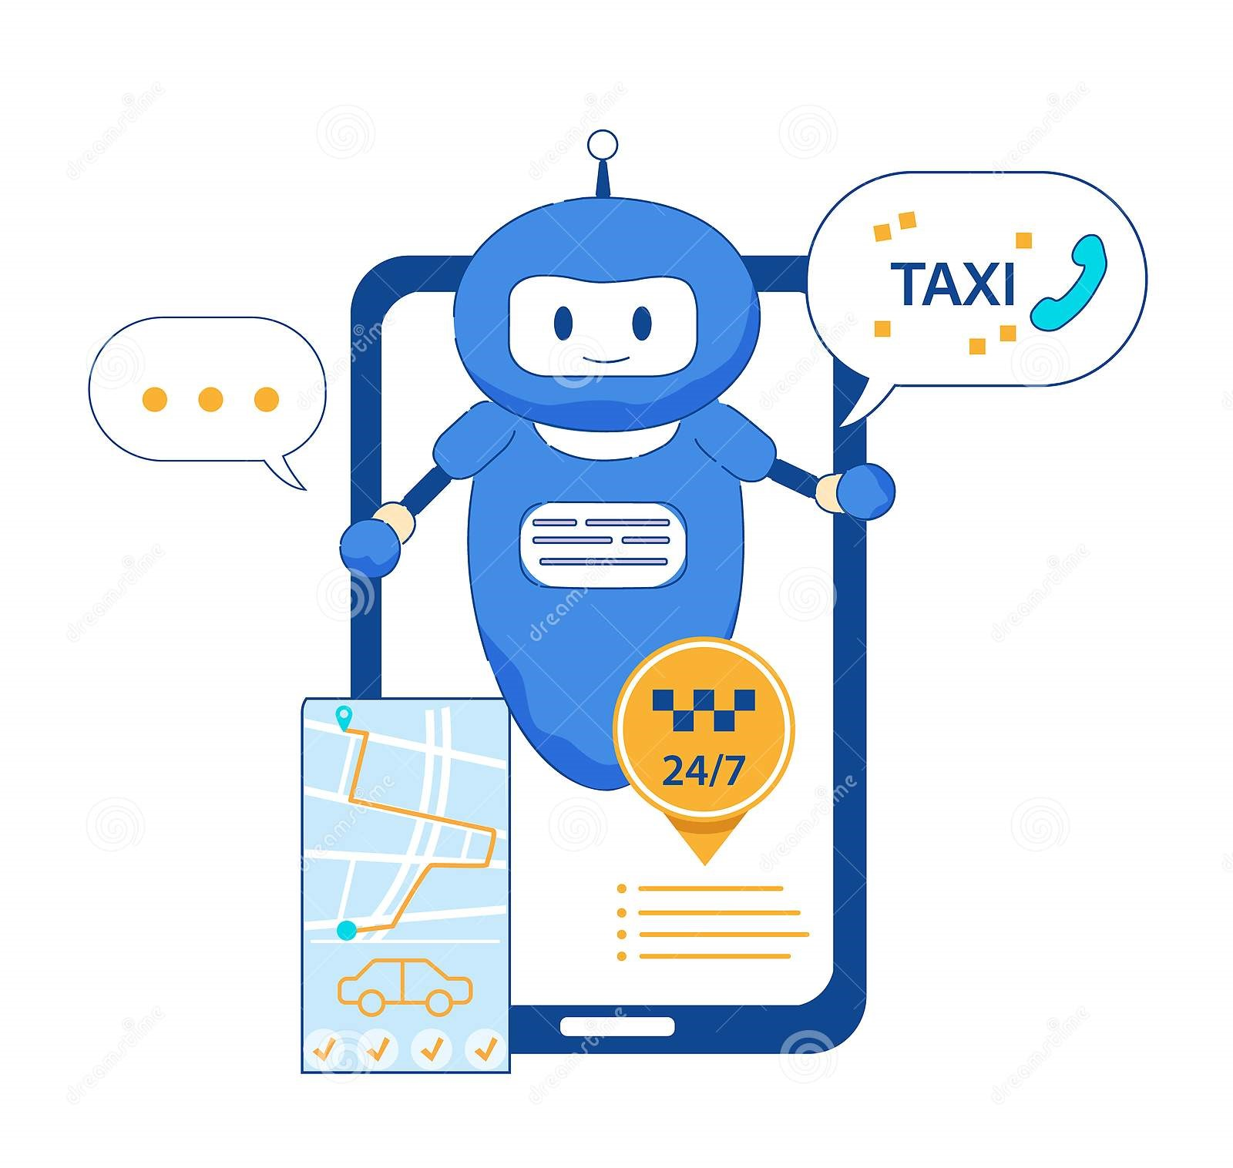
Thank You!

